Slide 1
United International University
Computer Networks Laboratory
CSE 324
FaceBook Group: Computer Networks Lab(CISCO)
Link: https://www.facebook.com/groups/CN324/
Azim Uddin Chowdhury
UIU CISCO Networking Academy
Phone: 01741125920
Mail: azim.cy@gmail.com

Slide 2
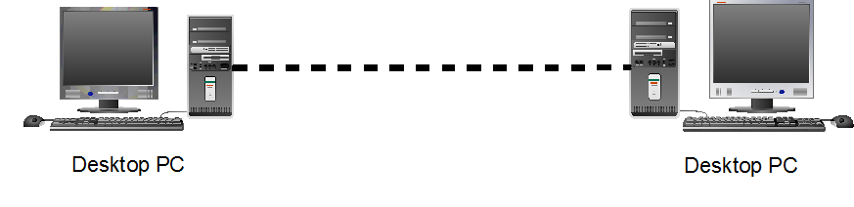
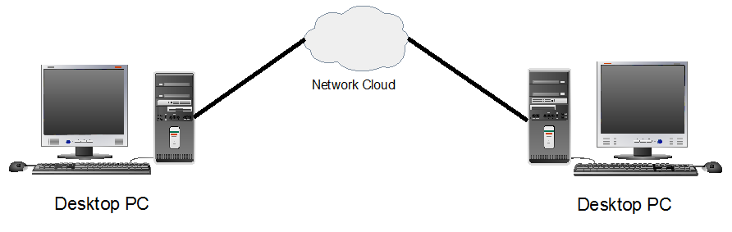
Computer Networks

Slide 3
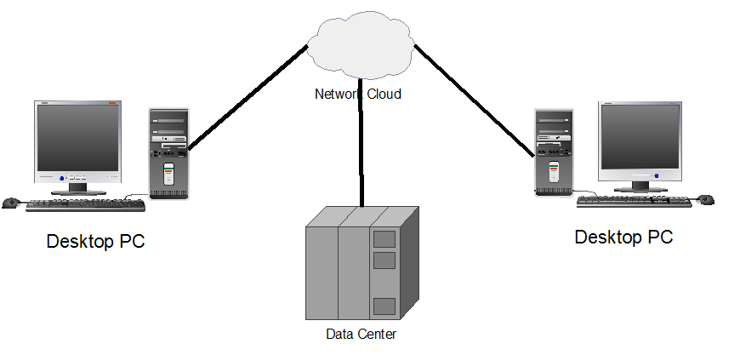
Computer Networks

Slide 4
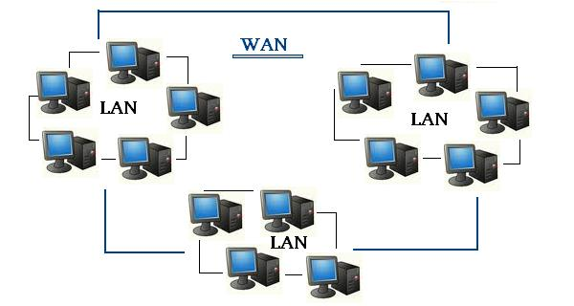
Two very common types of networks
Network
LAN
WAN
LAN: Local Area Network
WAN: Wide Area Network

Slide 5
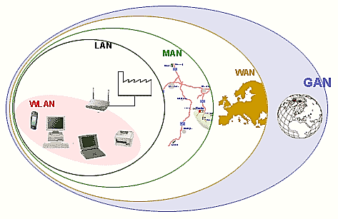
Two very common types of networks
Other types of networks include:
Metropolitan Area Network (MAN)
Wireless LAN (WLAN)
Storage Area Network (SAN)

Slide 6
Network Address
Two Type of in Computer Networks
1. Internet Protocol(IP)
Two Types of IP:
→ IPv4: Internet Protocol version 4
IPv4 Length: 32 bits
→ IPv6: Internet Protocol version 6
IPv6 Length: 128 bits
IP Address: 32 bit
Example: 192.168.1.1 192.168.1.1→11000000.10101000.00000001.00000001
IP Address
PC→RUN→CMD
ipconfig
2. Physical Address/MAC Address
→MAC (Media Access Control) is A Unique Identifier
→ 48bits Hexadecimal Address
→ Ex. 00:0a:95:9d:68:16
→ First Three Octets are Manufacturers ID
Dell: 00-14-22
Cisco: 00-40-96
Host name, IP & MAC Address
PC→RUN→CMD
ipconfig /all
Notes:
Section 1.2.1.5

Slide 7
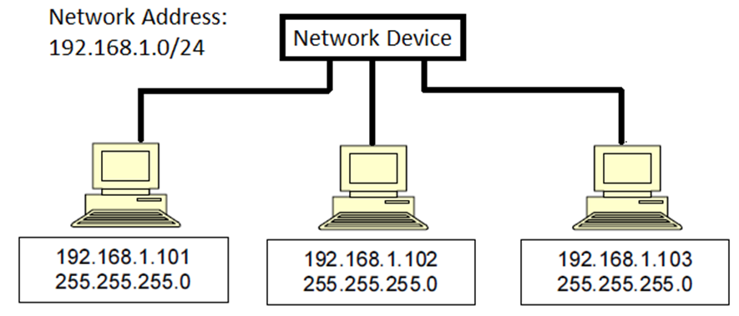
LAN: Local Area Network

Slide 8
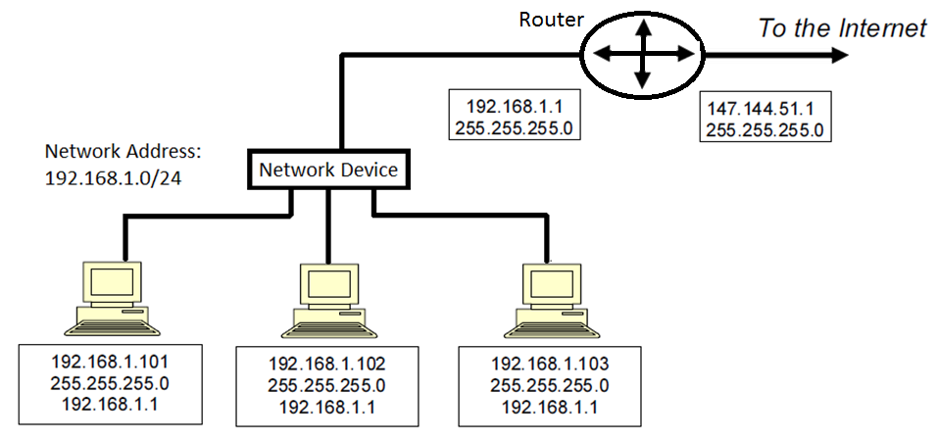
LAN: Local Area Network

Slide 9
Computer Network configuration
Connectivity Test : ping(Packet Internet Groper ) command
PC command:
Ifconfig
Ifconfig /all
Ping
tracert

